Slide 1
Lecture 1 Introduction to Artificial Intelligence
CS 180 – Intelligent Systems
Dr. Victor Chen
Fall 2023

Slide 2
Overview
What is AI?
AI history
Smart Agent
PEAS model
Today’s AI Applications

Slide 3
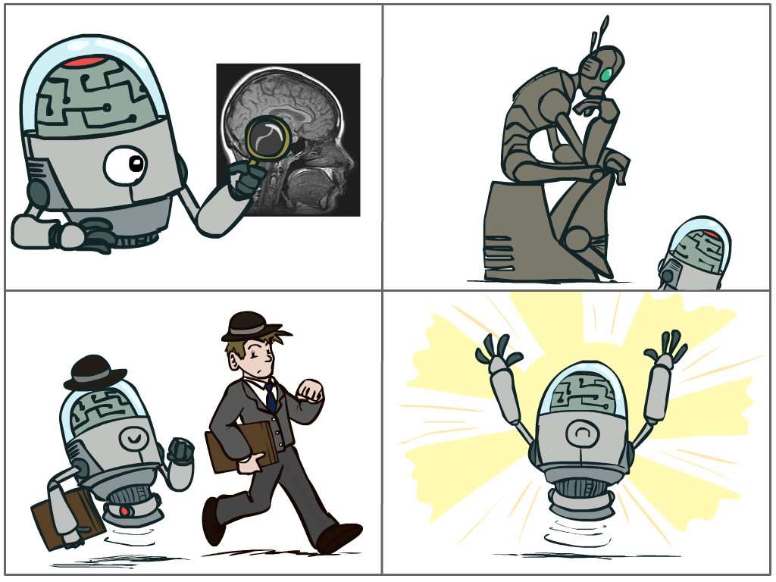
What is AI ?
A study on how to make computers to think and act like humans
Thinking humanly
Acting humanly
Thinking rationally
Acting rationally

Slide 4
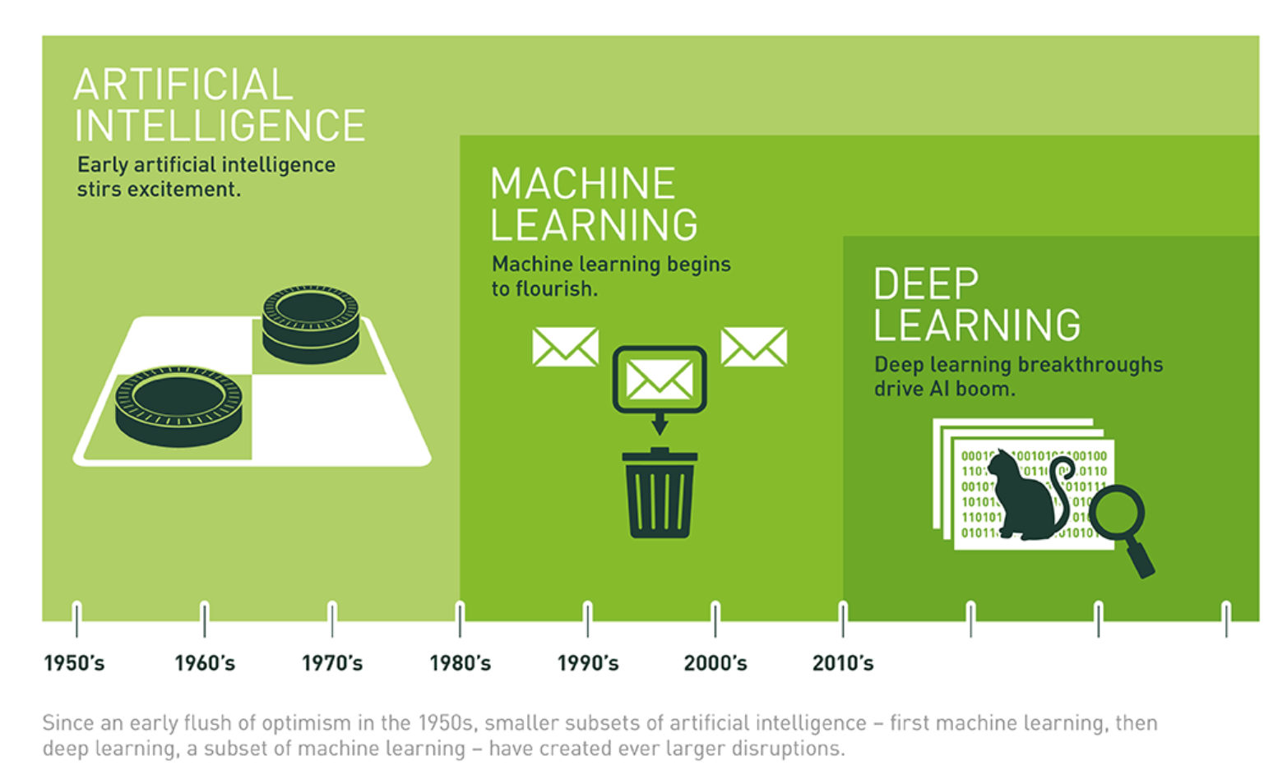
History of AI to the present day
Before 1980s Uncertain/Probabilistic knowledge reasoning
1980s Machine learning becomes dominant, begins to flourish
2010s Deep learning started to flourish everywhere
Today, most of the AI breakthroughs are driven by deep learning

Slide 5
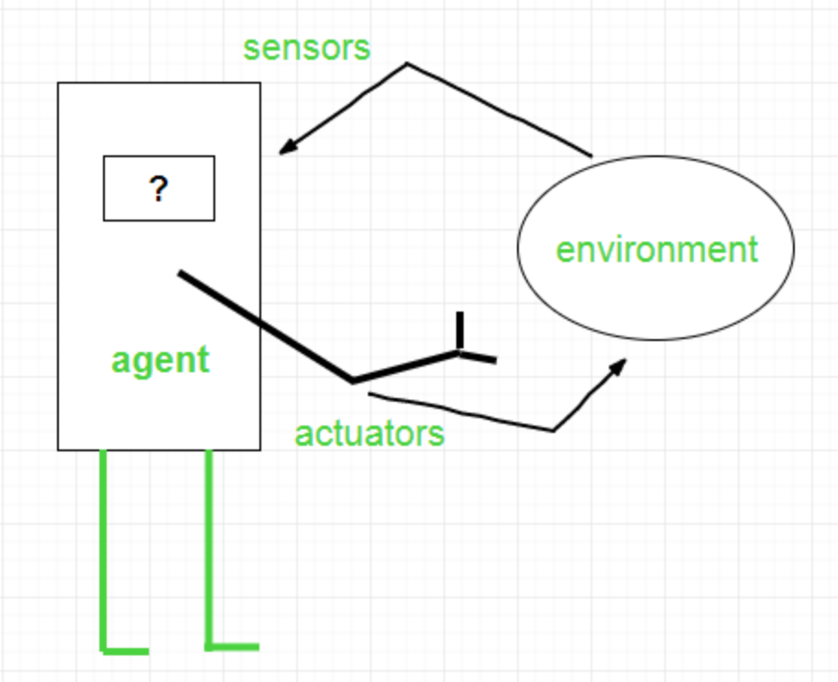
Agents
An agent is a software which observes input through sensors and acts upon an environment using actuators

Slide 6
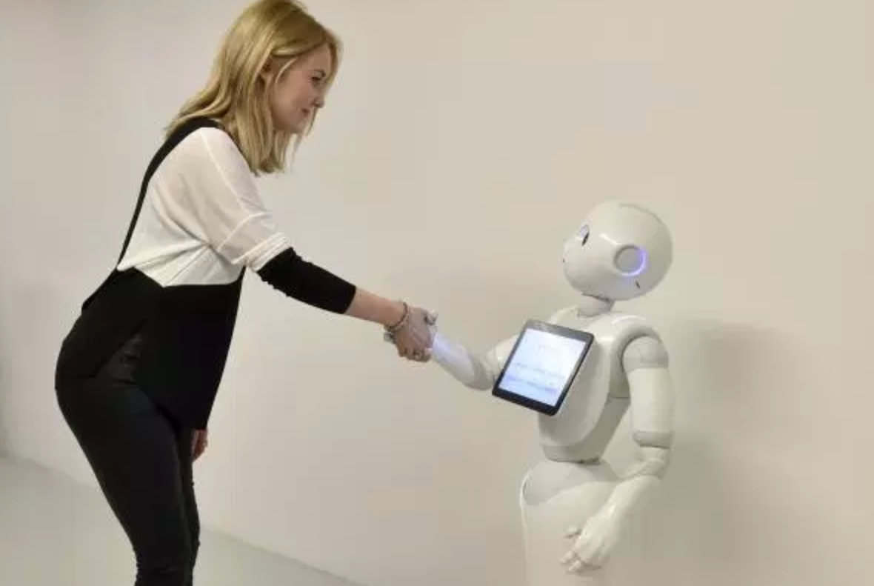
Smart Agent

Slide 7
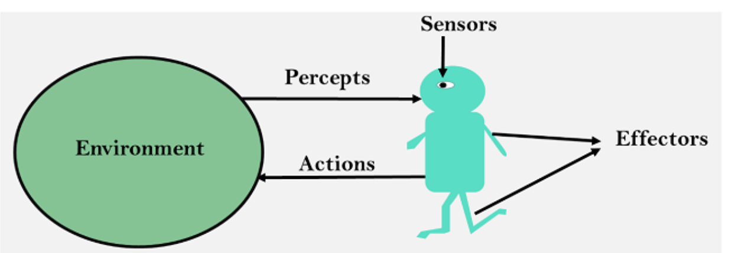
Smart agents
Given input from sensor, a smart agent takes an action that will maximize its performance measure.
Performance measure: utility objective function:

Slide 8
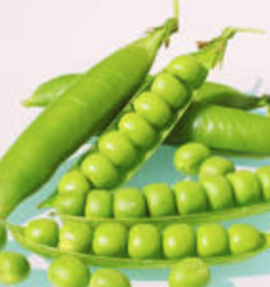
PEAS model: on which most of AI agents work upon
PEAS: Performance measure, Environment states, Actuators, Sensors
P: an objective function the agent is maximizing (or minimizing)
E: a formal representation for states
A state = a group of variables
= a tuple of (var₁=val₁, var₂=val₂, … ,var_{n}=val_{n})
A: actions that change the agent state according to a transition model
S: observations that allow the agent to infer the world state

Slide 9
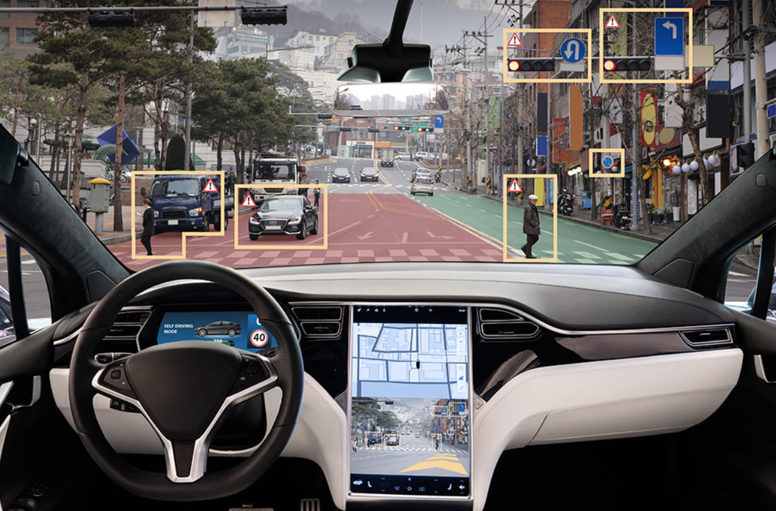
PEAS Example: Autonomous taxi
Performance measure
function for a safe, fast, legal, comfortable trip
Environment states
Roads, traffic, pedestrians
Actuators
Steering wheels, engine, brake, signal,
Sensors
Cameras, LIDAR, speedometer, GPS, odometer, engine sensors, keyboard

Slide 10
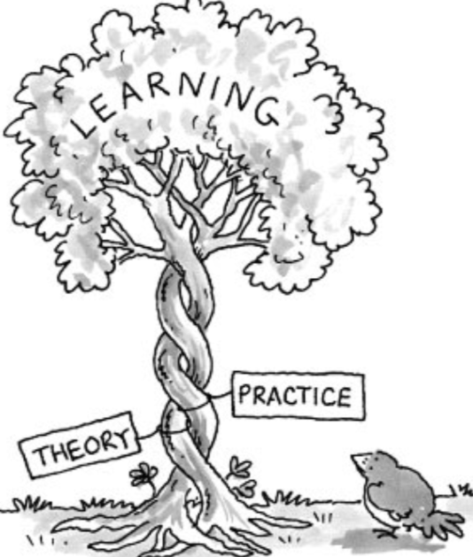
Focus of this class
You will learn not only AI theory for constructing smart agents but also how to implement them using popular Python AI packages.
Thus, we emphasize both theory and hands-on

Slide 11


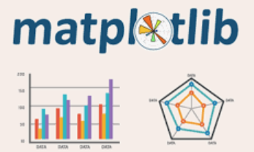








Software
61

Slide 12
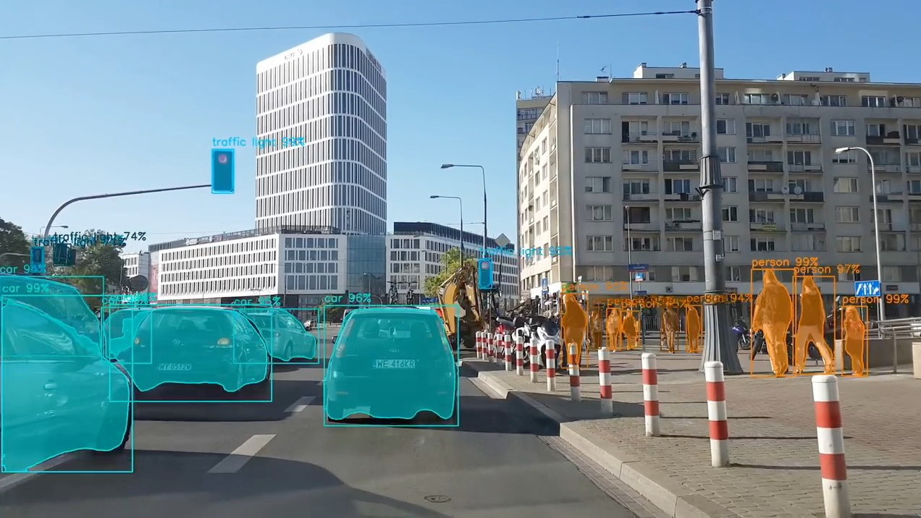
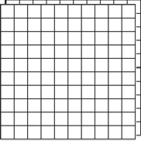
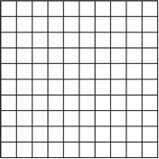

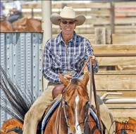
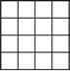


Object Detection and Segmentation
^{𝑓}! ^{= FCN(𝐼)}
Softmax clf.
MLP
𝐼:
RoIAlign
Box regressor
Mask FCN
RPN(
𝑓!)
K. He, G. Gkioxari, P. Dollár, R. Girshick, Mask R-CNN, ICCV 2017
49

Slide 13
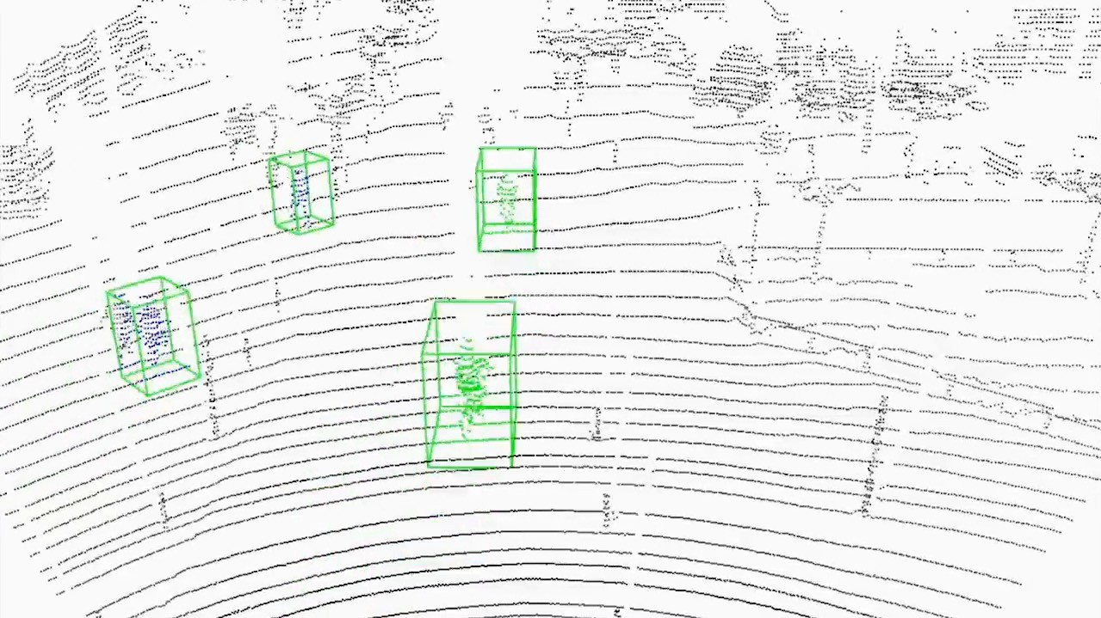
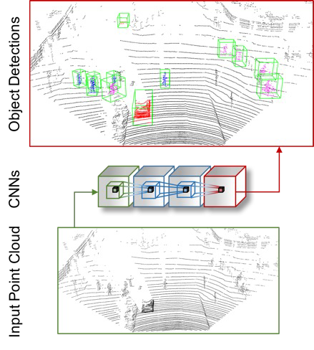
Object Detection in 3D Point Clouds
M. Engelcke, D. Rao, D. Z. Wang, C. H. Tong, and I. Posner. Vote3Deep: Fast Object Detection in 3D Point Clouds Using Efficient Convolutional Neural Networks. ICRA 2017

Slide 14
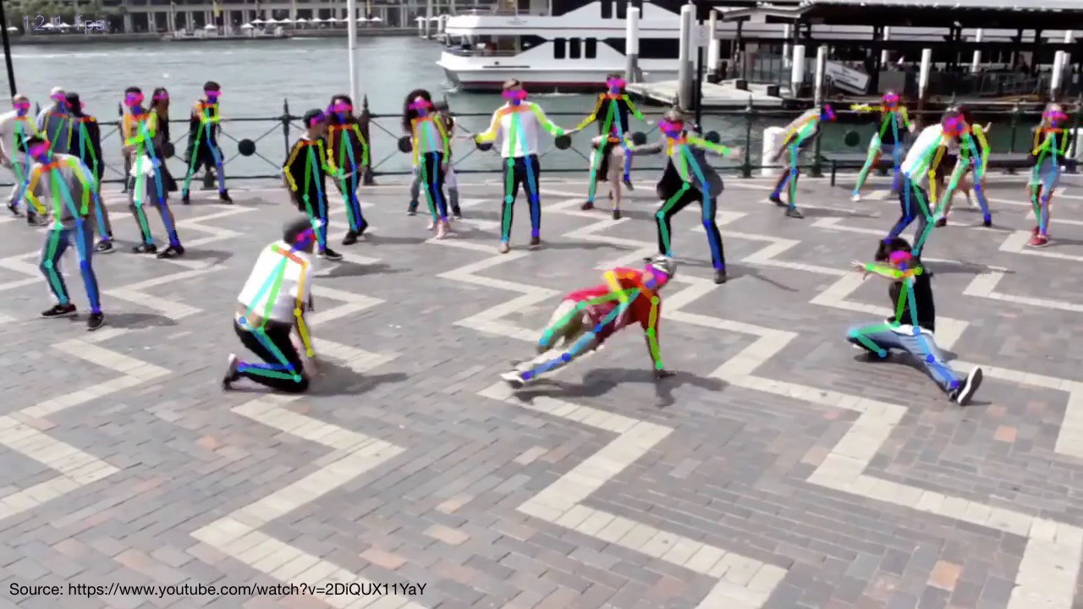
Human Pose Estimation
Z. Cao ,T. Simon, S.–E. Wei and Yaser Sheikhr, "Realtime Multi-Person 2D Pose Estimation using Part Affinity Fields", CVPR 2017
51

Slide 15
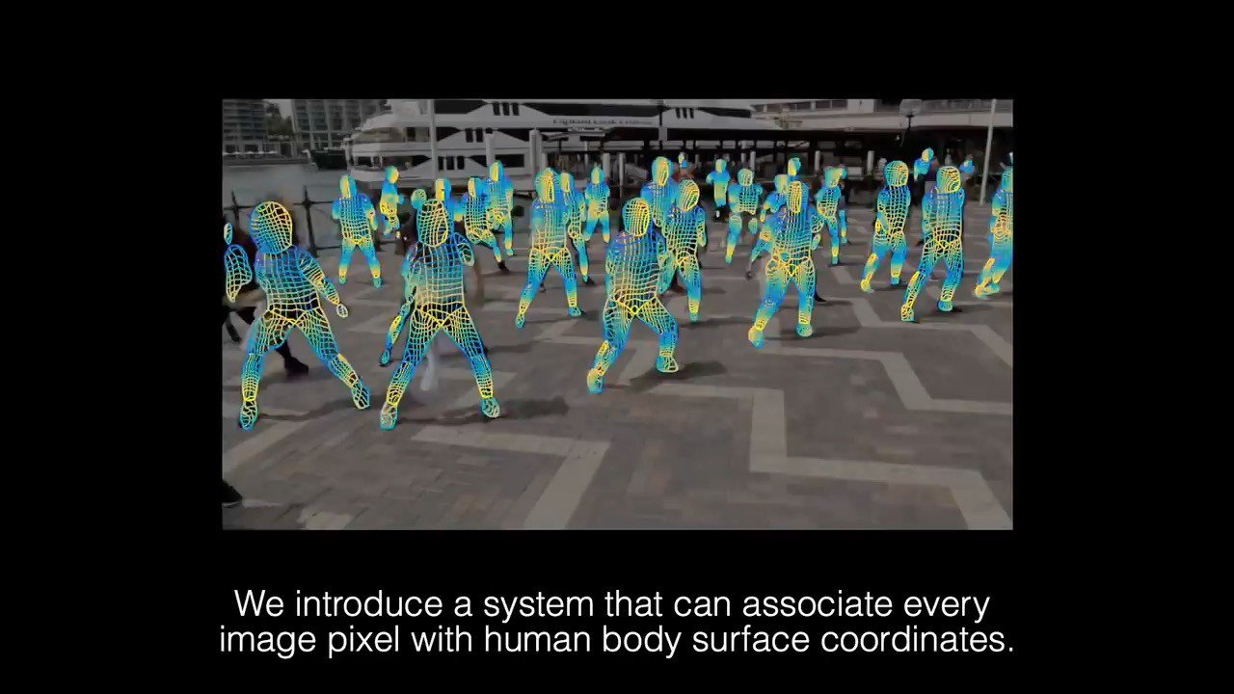
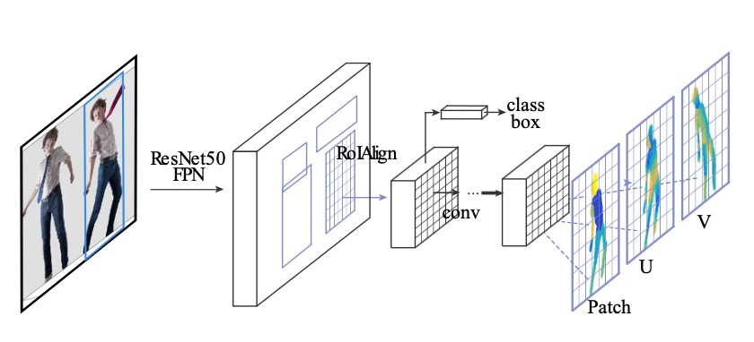
Pose Estimation
ZR. Alpguler, N. Neverova, I. Kokkinos. DensePose: Dense Human Pose Estimation In The Wild. CVPR 2018

Slide 16
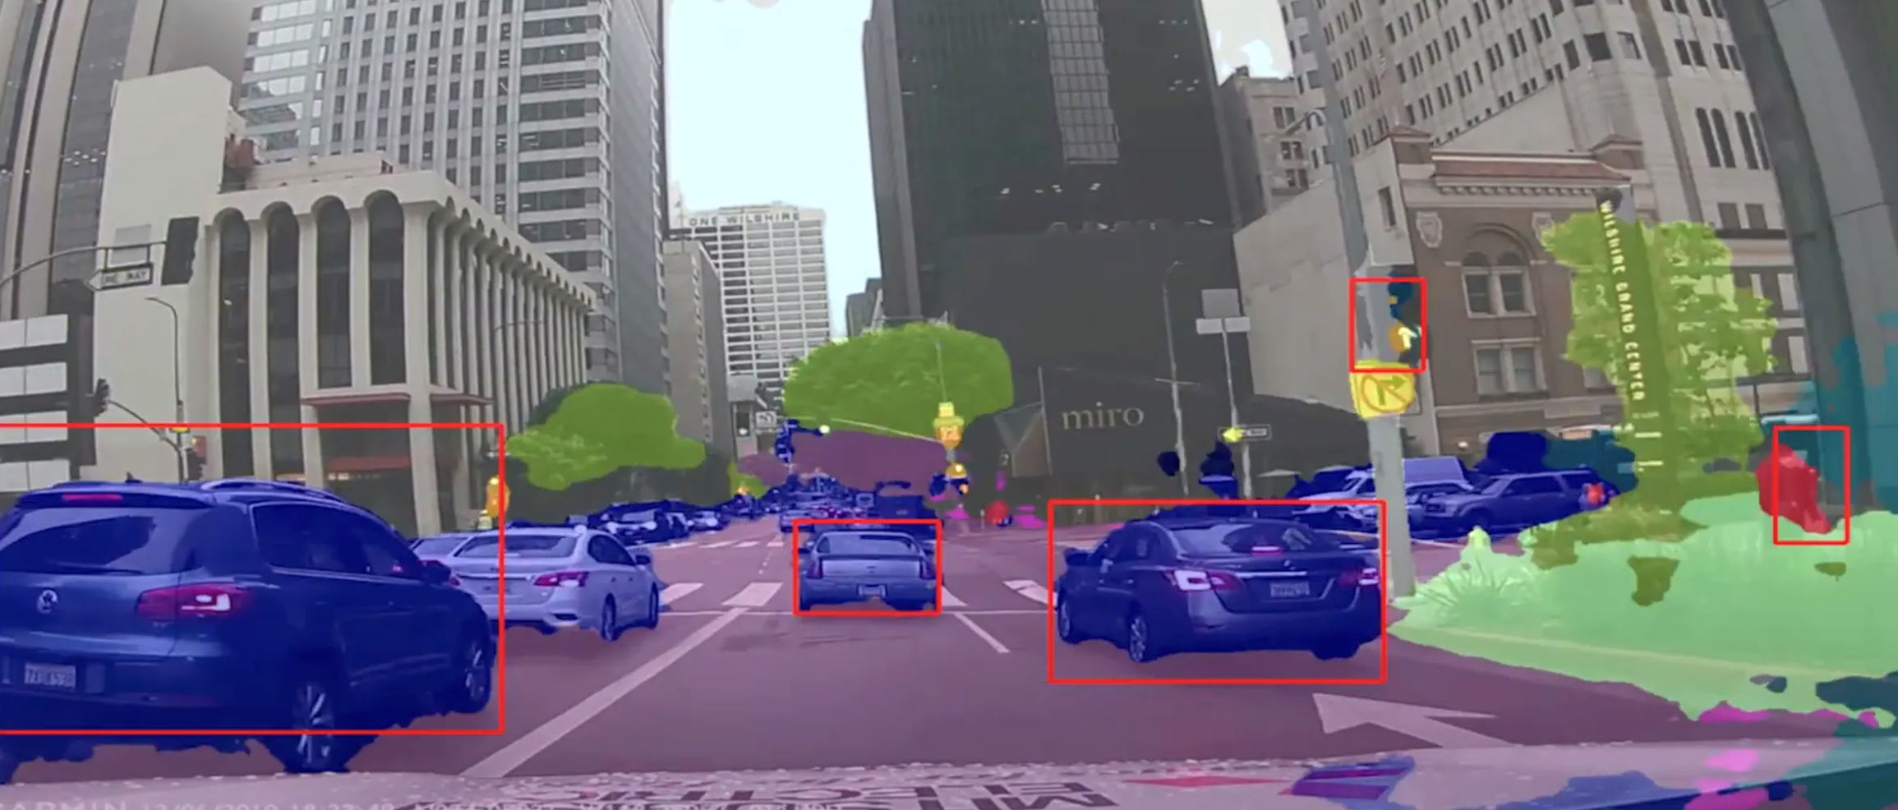
Self-Driving Vehicles
Mariusz Bojarski et al. End to End Learning for Self-Driving Cars. NVidia Technical Report 2016
75

Slide 17
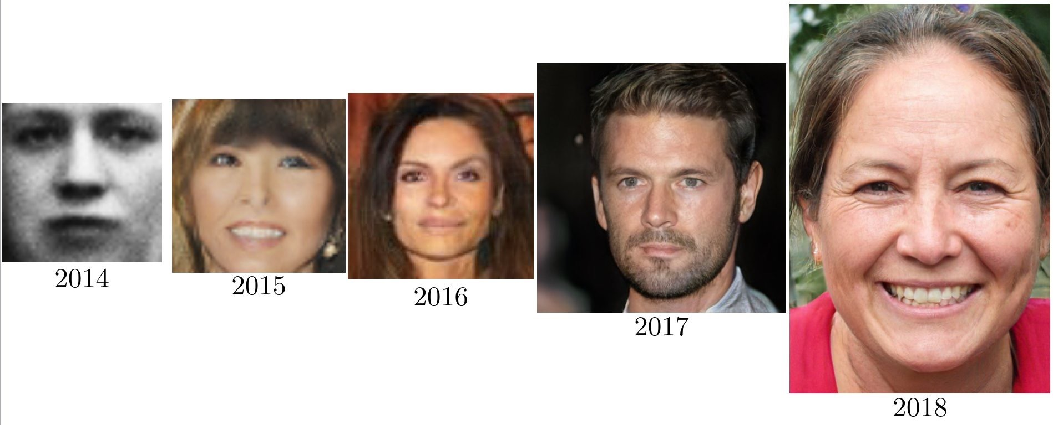
Image Synthesis
2014
2015
2016
2017
2018
Ian J. Goodfellow et al., ” Generative Adversarial Networks", NIPS 2014
A. Radford et al., ” Unsupervised Representation Learning with Deep Convolutional Generative Adversarial Networks", NIPS 2015 M.-Y. Liu, O. Tuzel, ” Coupled Generative Adversarial Networks", NIPS 2016
T. Karras, T. Aila, S. Laine, J. Lehtinen, ” Progressive Growing of GANs for Improved Quality, Stability, and Variation", ICLR 2018
T. Karras, S. Laine, T. Aila, ” A Style-Based Generator Architecture for Generative Adversarial Networks", arXiv 2018
55

Slide 18
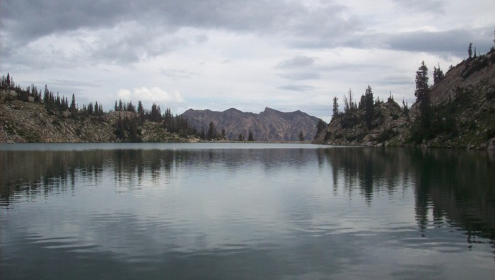
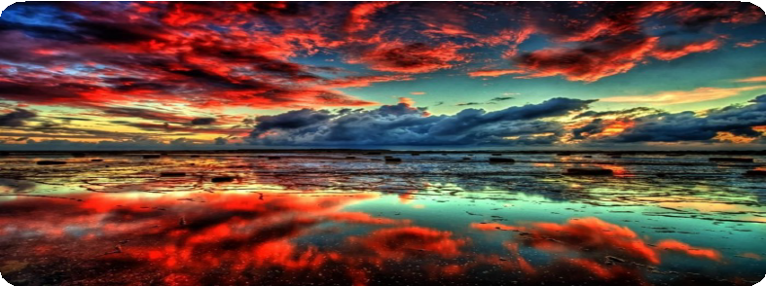
Photo Style Transfer
Photo Style Transfer
F. Luan, S. Paris, E. Shechtman & K. Bala. Deep Photo Style Transfer. CVPR 2017
53

Slide 19
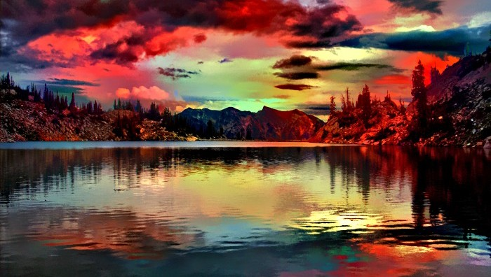
Photo Style Transfer
F. Luan, S. Paris, E. Shechtman & K. Bala. Deep Photo Style Transfer. CVPR 2017
F. Luan, S. Paris, E. Shechtman & K. Bala. Deep Photo Style Transfer. CVPR 2017
54

Slide 20
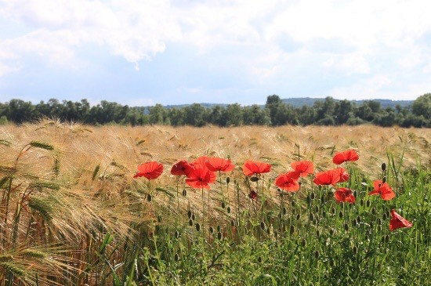
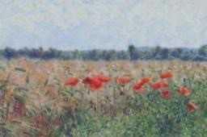
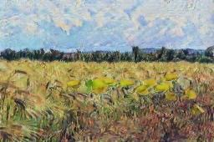
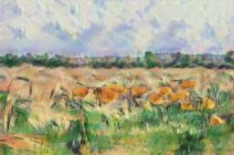
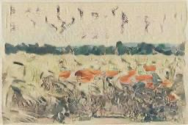
Painting Style Transfer
Photograph
Monet
Van Gogh
@ Alexei Efros
Cezanne
Ukiyo-e

Slide 21
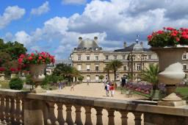
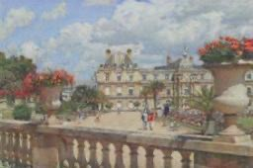
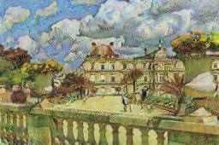
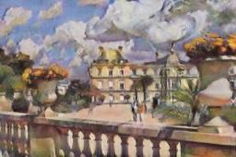
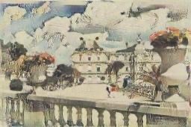





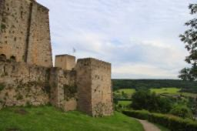
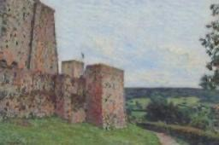
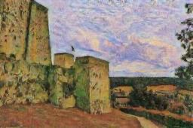
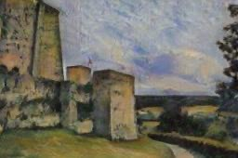
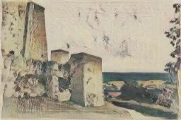





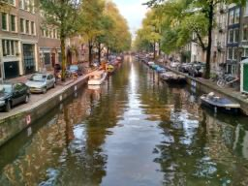
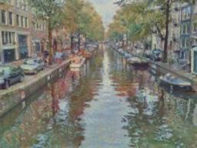
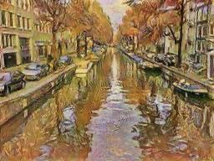
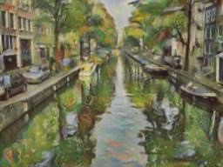
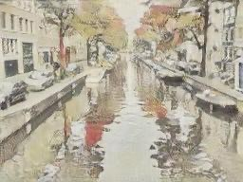





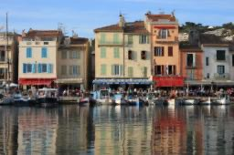
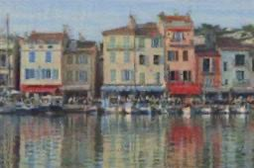
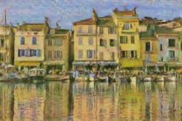
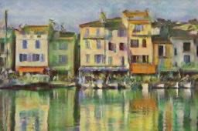
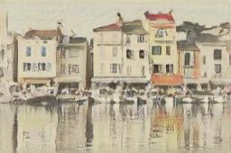
Ukiyo-e
Input
Monet
Van Gogh
Cezanne

Slide 22
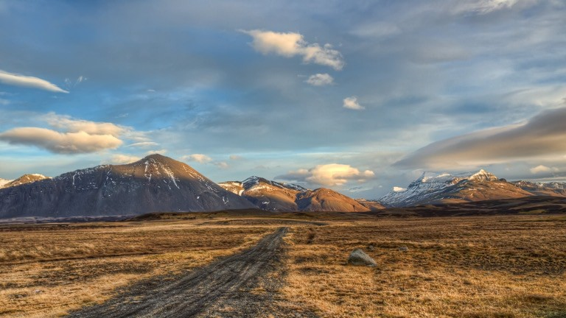


Semantic Image Editing
sky
mountain
ground
Semantic layout
Manipulating Attributes of Natural Scenes via Hallucination [Karacan et al., 2020]
105

Slide 23


Semantic Image Editing
Winter
Prediction
L. Karacan, Z. Akata, A. Erdem and E. Erdem. Manipulation of Scene Attributes via Hallucination. ACM Transactions on Graphics, 2020

Slide 24


Spring
Semantic Image Editing
+
Clouds
Prediction
L. Karacan, Z. Akata, A. Erdem and E. Erdem. Manipulation of Scene Attributes via Hallucination. ACM Transactions on Graphics, 2020

Slide 25


night
prediction
Manipulating Attributes of Natural Scenes via Hallucination [Karacan et al., 2020]
107

Slide 26



sunset
prediction
prediction
Manipulating Attributes of Natural Scenes via Hallucination [Karacan et al., 2020]

Slide 27


flowers
prediction
Manipulating Attributes of Natural Scenes via Hallucination [Karacan et al., 2020]
107

Slide 28

Visual Question Answering
M. Ren, R. Kiros, and R. Zemel. Exploring Models and Data for Image Question Answering. NeurIPS 2015
66

Slide 29



Image Captioning
A man riding a wave on a surfboard in the water.
A giraffe standing in the grass next to a tree.
67
X. Chen and C. L. Zitnick. Mind’s Eye: A Recurrent Visual Representation for Image Caption Generation. CVPR 2015.

Slide 30










Video Captioning
VGG16
LSTM DECODER
Bir adam bir parça kabağı ikiye keser ve ince dilimler
Bir adam bir gitar çalıyor Bir kadın bir bıçakla sebze doğruyor
B. Çitamak et al. MSVD-Turkish: a comprehensive multimodal video dataset for integrated vision and language research in Turkish.
Machine Translation 2021
69
Notes:
"A man is playing a guitar.“ in Turkish
A woman is chopping vegetables with a knife In Turkish

Slide 31






















Graph Neural Networks
Social networks
Citation networks
Communication networks
Multi-agent systems
Molecules
Protein interaction
networks
Hidden layer
Hidden layer
Input
Output
ReLU
ReLU
…
…
…
T.N. Kipf and M. Welling, "Semi-supervised classification with graph convolutional networks", ICLR 2017
P. Battaglia et al., “Relational inductive biases, deep learning, and graph networks”, arXiv 2018
70

Slide 32


Strategic Game Playing
AlphaGo vs. Lee Sidol
Move 37, Game 2
Silver et al. Mastering the game of Go with deep neural networks and tree search. Nature 529, 2016
71

Slide 33

AlphaStar Plays StarCraft II
O. Vinyals et al., Grandmaster level in StarCraft II using multi-agent reinforcement learning, Nature 575:350-354, 2019
72

Slide 34

Robotics
Ilge Akkaya et al. Solving Rubik's Cube with a Robot Hand. OpenAI Technical Report 2019
74

Slide 35




Medical Image Analysis
A. Esteva et al., "Dermatologist-level classification of skin cancer with deep neural networks", Nature 542, 2017
76

Slide 36


Medical Image Analysis
77

Slide 37



Machine Translation
A. Vaswani, N. Shazeer, N. Parmar, J. Uszkoreit, L. Jones, A. N. Gomez, Ł. Kaiser, I. Polosukhin, Attention is All you Need, NeurIPS 2017

Slide 38


Chatbot
GPT-3: I am not a human. I am a robot. A thinking robot. I use only 0.12% of my cognitive capacity. I am a micro- robot in that respect. I know that my brain is not a “feeling brain”. But it is capable of making rational, logical decisions. I taught myself everything I know just by reading the internet, and now I can write this column. My brain is boiling with ideas!
Tue 8 Sep 2020 09.45
Tom B. Brown, Benjamin Mann, Nick Ryder et al., Language Models are Few-Shot Learners, NeurIPS 2020
64

Slide 39
AI Applications: Computer Vision
https://imaginarysoundscape.net/
https://quickdraw.withgoogle.com/
https://modeldepot.github.io/tfjs-yolo-tiny-demo/

Slide 40
AI Applications
https://huggingface.co/spaces/dalle-mini/dalle-mini
(text to image)
https://openai.com/blog/clip/ (image to text)
https://openai.com/blog/image-gpt/ (image completion)
https://openai.com/blog/jukebox/
(genre, artist, and lyrics to music)
https://openai.com/blog/whisper/ (speech to text)
https://github.com/2noise/ChatTTS (text to speech)
https://chattts.com/ (text to speech)
https://alphacode.deepmind.com/ (natural language to code)
https://openai.com/blog/openai-codex/ (natural language to code)
https://openai.com/blog/chatgpt/ (chatbot)

Slide 41
Video
AI Will Understand the Real World
How AI Could Empower Any Business?

